Slide 1
Programming in R
Lecture-4

Slide 2
Data Frames
A data frame is a table or a two-dimensional array-like structure in which each column contains values of one variable and each row contains one set of values from each column.
Following are the characteristics of a data frame.
The column names should be non-empty.
The row names should be unique.
The data stored in a data frame can be of numeric, factor or character type.
Each column should contain same number of data items.

Slide 3
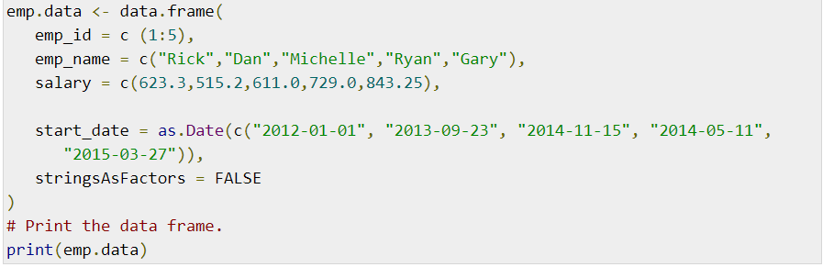
Create Data Frame

Slide 4
Summary of Data in Data Frame
print(summary(emp.data))

Slide 5

Extract Data from Data Frame

Slide 6

Extract the first two rows and then all columns

Slide 7
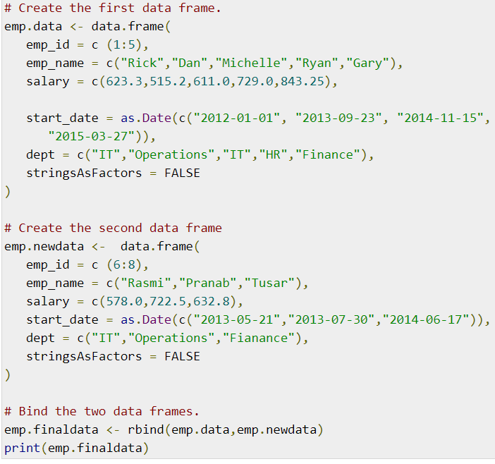
Add Row
To add more rows permanently to an existing data frame, we need to bring in the new rows in the same structure as the existing data frame and use the rbind() function.

Slide 8
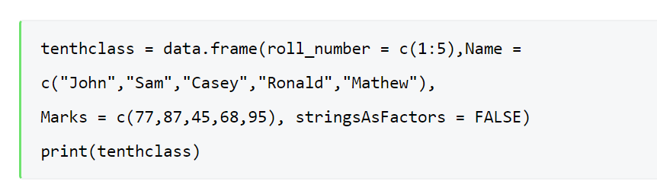
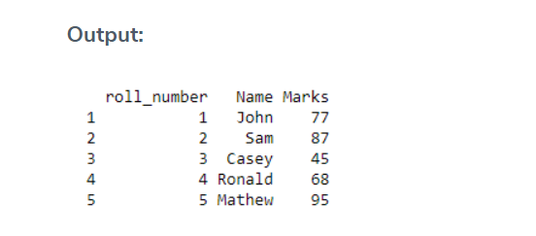
Add Column

Slide 9
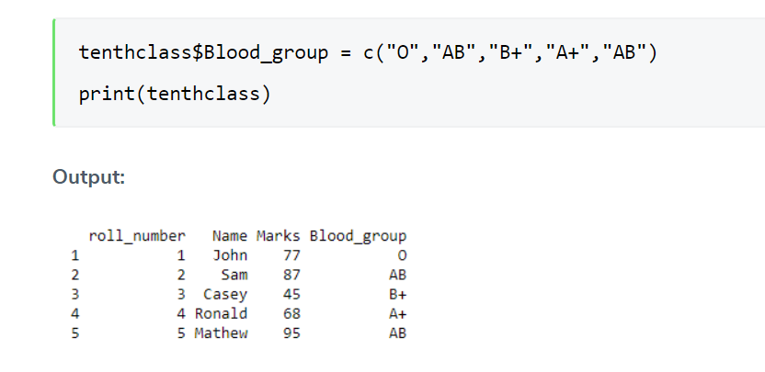
Now consider a case wherein we have to add blood group details of each and every student in class 10. We will add a new column for it and name it as “Blood_group”.

Slide 10
Delete Column
tenthclass$Blood_group = NULL print(tenthclass)

Slide 11
Delete Row
tenthclass = tenthclass[-1,] print(tenthclass)

Slide 12
Update Data in Data Frame
Let’s suppose Sam scored 98 marks but as per our data frame marks are 87. So we can pass the below code to rectify it.
tenthclass$Marks[2] = 98 print(tenthclass)

Slide 13
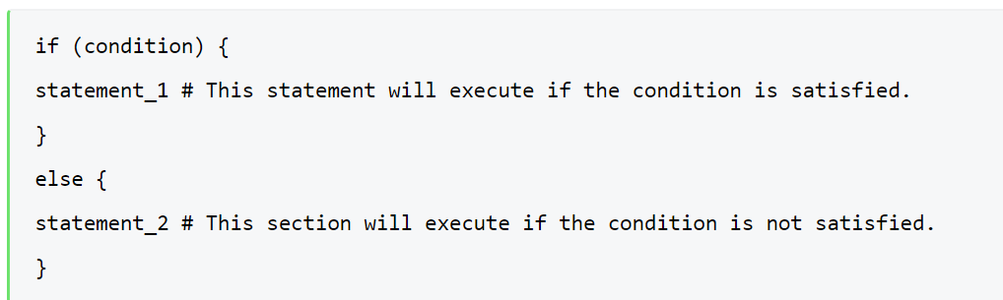
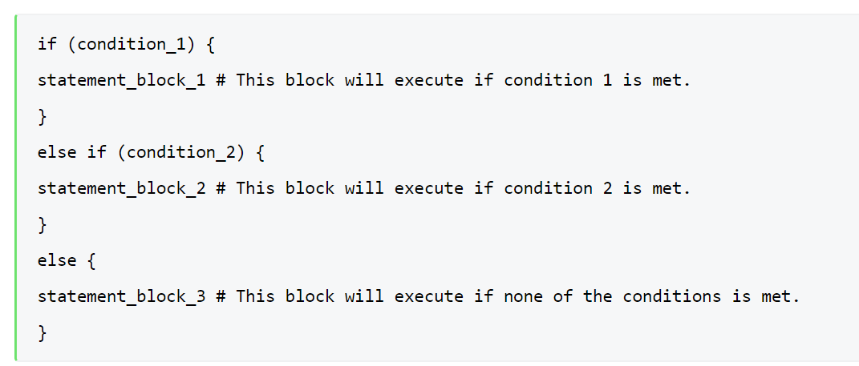
Control structures
If statement

Slide 14
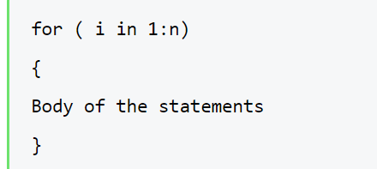
Loops in R
1. For Loops in R

Slide 15
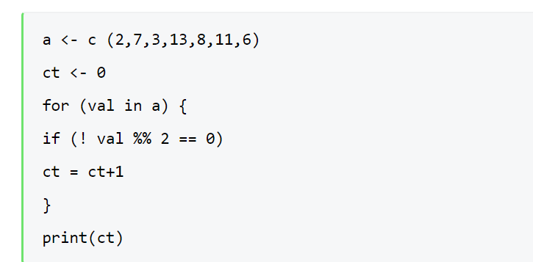
Example:To count the number of odd values in the list

Slide 16
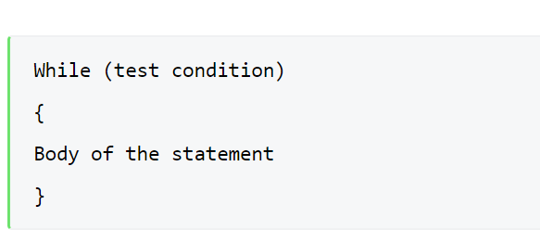
2. While Loop in R

Slide 17
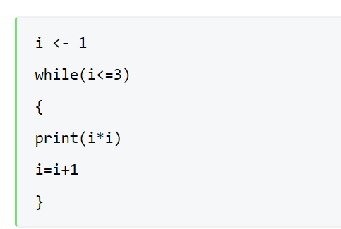
Example:To compute the square of the number until 3.

Slide 18
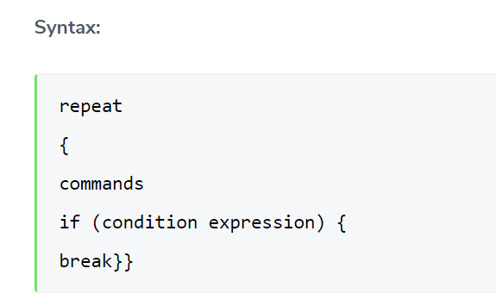
3. Repeat loops in R
This loop helps to execute the same code repeatedly until a stop condition is reached(break).

Slide 19
Data visualization in R
Data visualization is the technique used to deliver insights in data using visual cues such as graphs, charts, maps, and many others.
This is useful as it helps in intuitive and easy understanding of the large quantities of data and thereby make better decisions regarding it.

Slide 20
Types of Data Visualizations
Bar Plot
There are two types of bar plots- horizontal and vertical which represent data points as horizontal or vertical bars of certain lengths proportional to value of the data item.
They are generally used for continuous and categorical variable plotting.
By setting the horiz parameter to true and false, we can get horizontal and vertical bar plots respectively.
Bar plots are used for the following scenarios:
To perform a comparative study between the various data categories in the data set.
To analyze the change of a variable over time in months or years.

Slide 21
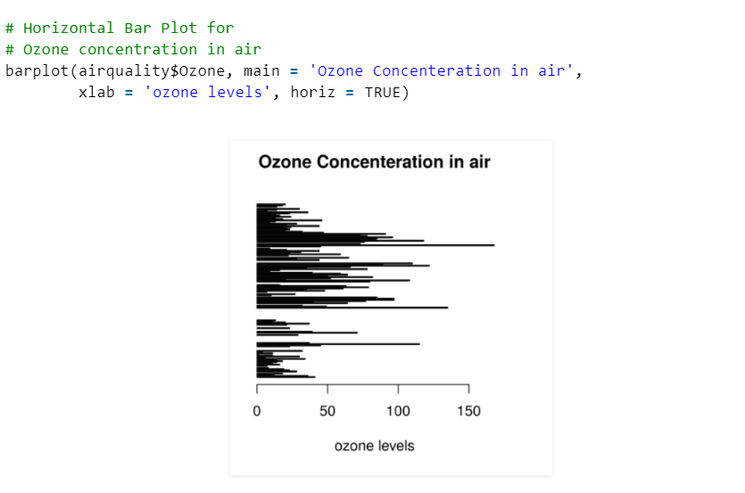

Slide 22

Histogram
A histogram is like a bar chart as it uses bars of varying height to represent data distribution. However, in a histogram values are grouped into consecutive intervals called bins. In a Histogram, continuous values are grouped and displayed in these bins whose size can be varied.
data(airquality)

Slide 23
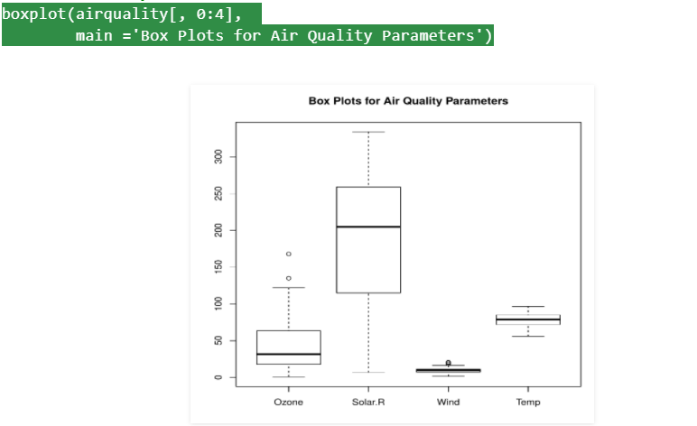
Box Plot
Statistical summary of the given data is presented graphically using a boxplot. A boxplot depicts information like the minimum and maximum data point, the median value, first and third quartile and interquartile range.

Slide 24
Box Plots are used for:
To give a comprehensive statistical description of the data through a visual cue.
To identify the outlier points that do not lie in the inter-quartile range of data.

Slide 25
Scatter Plot
A scatter plot is composed of many points on a Cartesian plane. Each point denotes the value taken by two parameters and helps us easily identify the relationship between them.
Scatter Plots are used in the following scenarios:
To show whether an association exists between bivariate data.
To measure the strength and direction of such a relationship.

Slide 26
